Slide 1
Introduction to Plant Classification

Slide 2
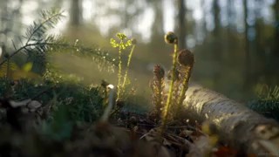
By the end of the lesson, you should be able to:
1. | Present the levels of plant classification and how it develops with new knowledge.
2. | Explain the main characteristics between the divisions.
3. | Present the classes and subclasses for the seed-producing plants.

Slide 3
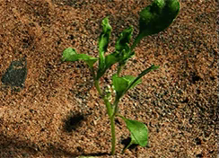
A Greek philosopher named Aristotle developed one of the first widely used classification systems for plants.
His system divided plants into groups on the shape of their stem. Although this is still a useful system, it had limitations.

Slide 4

Today we use different features to classify plants.
Those features include seeds, roots, stems, flowers and leaves. It gives us much more insight into how different groups of plants live and function.

Slide 5
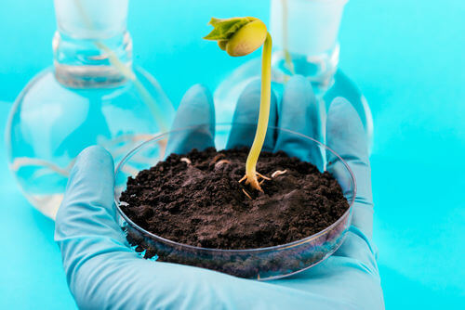
Plant taxonomy benefits from new technologies and knowledge.
Taxonomy is the science that identifies, describes, classifies and names each organism. It's not a new field as humans have felt the need to order the world around them for a very long time.
However, our recent understanding of evolutionary processes and genetics bring new tools to classify organisms.

Slide 6
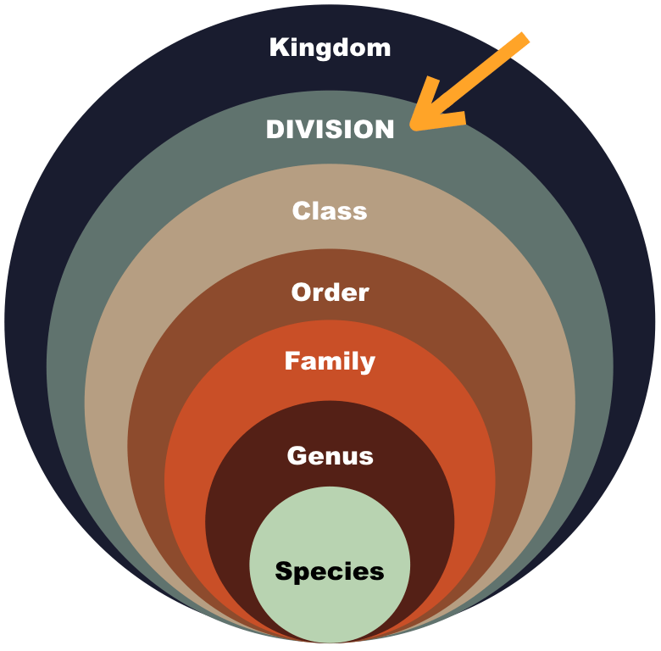
Plant classification follow the Linnaean system.
.
All plants are in the Kingdom Plantae (latin for plants). Instead of 'phylum', plants are then grouped in 'divisions'. Apart from this, the main levels are the same:

Slide 7
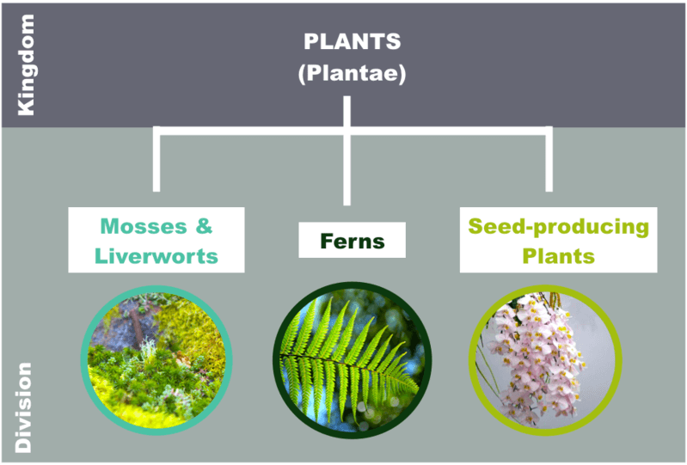
There are three main divisions of the plant kingdom.
These are Mosses and Liverworts, Ferns and Seed-producing plants.
These divisions are characterized by the way they reproduce and whether or not they have an organised system for transporting nutrients (food) around the plant.

Slide 8
Mosses and liverworts are found in damp places.
They absorb water from the surrounding environment, so they must live in a damp habitat or they will dry out!
Their root-like structures are very fine and hair-like. They also have simple leaves or leaf-like structures. Mosses and liverworts reproduce using spores.

Slide 9
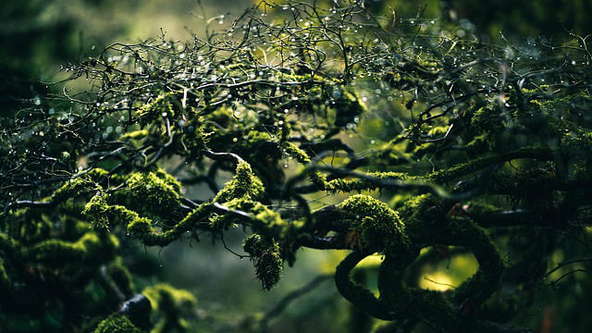
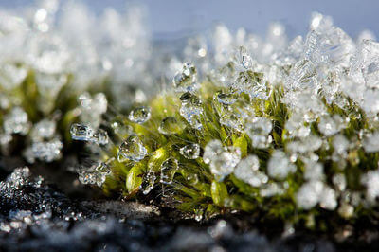
Mosses and liverworts are usually very small (only a few centimetres long).
This is because they do not have any vascular system that can carry water and nutrients through the plants.

Slide 10
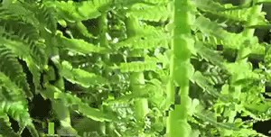
Ferns are found in damp, shaded areas like dense forests.
They reproduce using spores rather than seeds, which are found on the underside of their leaf-like fronds.
Contrary to mosses and liverworts, they have a network of tubes called a vascular system for transporting food and nutrients.

Slide 11
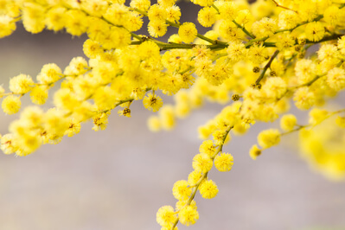
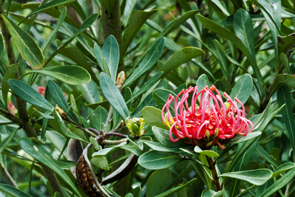
Seed-producing plants are a very large and diverse group of plants.
However, they all have vascular systems and reproduce using seeds!
Seed-producing plants native to Australia include for example: the Wollemi pine (Wollemia nobilis), the blue gum (Eucalyptus globulus), the golden wattle (Acacia pycnantha, left picture) or the waratahs (Telopea, right).

Slide 12

Other characteristics are used to create smaller groups of plants into each division.
Let's take the example of seed-producing plants. They can be organised in classes and even subclasses!

Slide 13
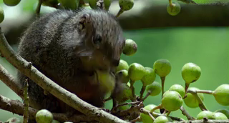
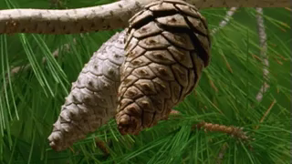
There are two classes of seed-producing plants
Those are Angiosperms and Gymnosperms.
Angiosperms are also called flowering plants and their seeds are enclosed within an ovary (usually a fruit). Gymnosperms have no flowers or fruits, their seeds are unenclosed or 'naked' (they are often cones).

Slide 14
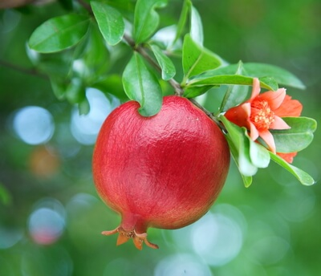
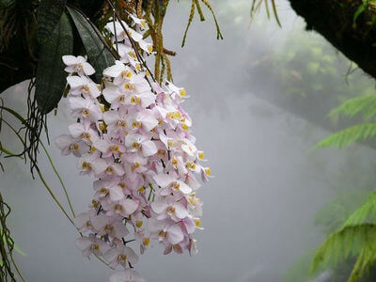
Angiosperms are divided in 2 subclasses.
Those subclasses are: monocotyledons and dicotyledons. They have a few distinct structural features. The first difference is visible early in their development with the number of cotyledons.
Cotyledons are the first leaves to appear in the plant. Monocotyledons have one cotyledon and dicotyledons have two.

Slide 15
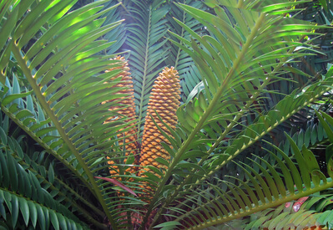
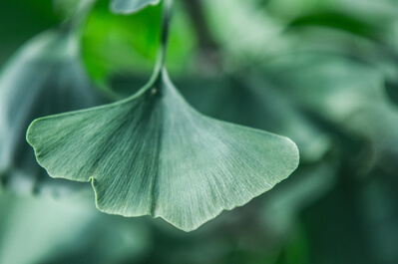
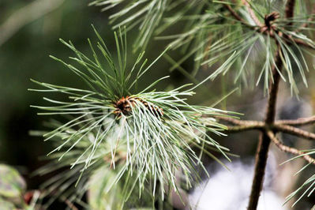
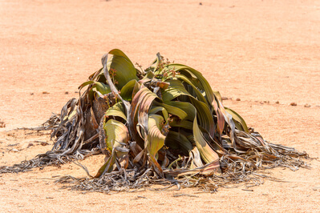
Gymnosperms have 4 subclasses.
Those are: cycads (top left), gingkos (top right), conifers (bottom left) and gnetophytes (bottom right).

Slide 16
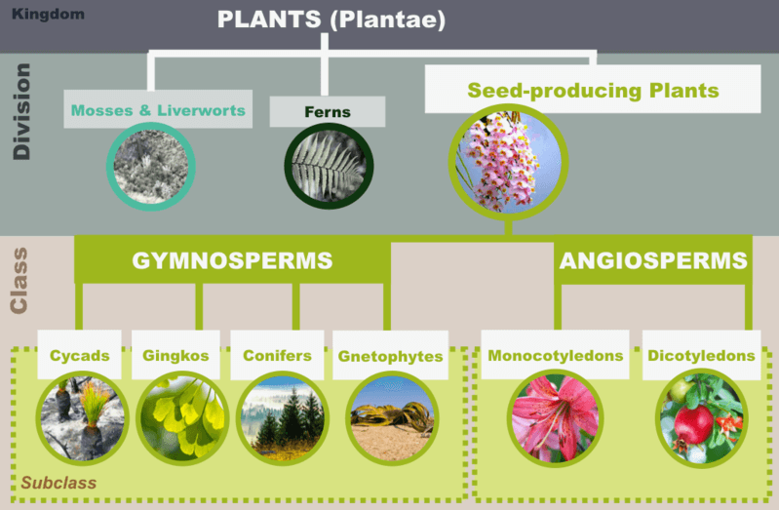
Here is a diagram to recap all this info about seed-producing plants classes and subclasses!

